Slide 1
Wellness Pointe and
OSHA Respiratory Protection Program
In compliance with:
OSHA Standard 29 CRF 1910.134
Purpose: To ensure employees are protected against exposure to respiratory hazards in the workplace.

Slide 2

Meet your Wellness Pointe
Respiratory Protection Administrator
Dr. Jennifer Smith, DDS

Slide 3
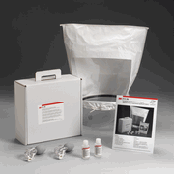
Respiratory Protection Training
Respirator
Fit Testing
Fit Testing for Wellness Pointe is performed by Taylor Safety, Longview, Texas on newly hired employees and annually* thereafter.
*unless employee needs to be tested sooner due to respirator not fitting properly and/or failing self-seal checks

Slide 4
Objectives
Describe the role of the fit tester and the fit testing process
Explain when respirator fit testing is required and for whom
Review equipment needed to perform respirator fit testing
Demonstrate correct donning and doffing of a respirator
Perform positive and negative respirator self-seal checks
Correctly perform respirator fit testing process
Describe record keeping requirements related to fit testing
Notes:
Learn to safely don, seal check, and doff an N95 respirator
Learn how to properly fit-test an N95 respirator and teach others

Slide 5
Fit Testers
No special certification required for Fit Testers
Fit Tester must be able to:
  Ensure that equipment is in proper working order
  Perform the tests properly
  Recognize invalid tests
Train other Fit Testers and provide required respiratory protection training
Notes:
Read Bullets
Add: After this training (both presentations), students will be able to
Conduct Fit Testing
Train other Fit Testers
Conduct Respiratory Protection Training

Slide 6
Fit Test Frequency
29 CFR 1910.134(f):
“Before an employee may be required to use any respirator with a negative or positive pressure tight-fitting facepiece, the employee must be fit tested with the same make, model, style, and size of respirator that will be used.”

Slide 7
Fit Test Frequency
Prior to initial use in the workplace
Whenever a different respirator is used or change in physical characteristics of respirator despite same model number
At least annually thereafter
  Or “in accordance with federal, state, and local regulations”

Slide 8
Fit Test Frequency
Employee reports or visible observations made of changes in physical condition that could affect respirator fit
  Facial scarring
  Dental changes
  Cosmetic surgery
  Obvious change in body weight
Notes:
The employer shall conduct an additional fit test whenever the employee reports, or the employer, PLHCP, supervisor, or program administrator makes visual observations of, changes in the employee's physical condition that could affect respirator fit. Such conditions include, but are not limited to, facial scarring, dental changes, cosmetic surgery, or an obvious change in body weight.

Slide 9
Fit Test Protocols
Quantitative Fit Test – (QNFT)
  Assessment by numerically measuring amount of leakage into the respirator
  QNFT more precise – more complex and costly
  QNFT not first choice for VDH fit testing program
    May be used for those unable to use Qualitative method

Slide 10
Fit Test Protocols
Qualitative Fit Test – (QLFT)
  Only used for negative pressure APRs that must achieve a fit factor of 100 or less (half-masks)
  A pass/fail test to assess the adequacy of fit – relies on response to test agent
  QLFT more accessible and economical – downside is that relies on subjective response
  4 acceptable protocols – depends on type of respirator in use
  Protocols for 95, 99 or 100 series filters:
    Bitrex Solution aerosol – VDH recommended protocol
    Saccharin solution aerosol – alternative protocol
Notes:
4 Protocols:
Isoamyl Acetate Protocol
Odor Threshold Screening
Saccharin Solution Aerosol Protocol
BitrexTM (Denatonium Benzoate) Solution Aerosol Protocol
Irritant Smoke (Stannic Chloride) Protocol
uses a person's response to the irritating chemicals released in the "smoke" produced by a stannic chloride ventilation smoke tube to detect leakage into the respirator

Slide 11
OSHA Respiratory Protection
Training Requirements
Medical clearance needed prior to fit testing and use of any respirator
Individual completes medical questionnaire
Review and signature of physician or other licensed health care professional (PLHCP) required prior to fit testing and respirator use
Some need additional medical evaluation and testing before clearance given
Notes:
Show/Refer to Questionnaire
Show/Refer to Medical Recommendation form

Slide 12
OSHA Respiratory Protection
Training Requirements
No employee will be permitted to work with a respirator until trained in respiratory protection
Must cover the following topics annually:
  General requirements of appropriate federal & state respiratory protection standards
  Potential work-related respiratory hazards and risks associated with not using and maintaining respirator properly
  Function, capabilities, limitations of selected respiratory protection
  How to inspect, don and remove, check seals, and wear the respirator properly
  Medical s/sx that might limit/prevent effective use of respirators
+
Notes:
Employees are not permitted to work with a respirator until they have been properly trained in respiratory protection
1910.134(k)(3) The employer shall provide the training prior to requiring the employee to use a respirator in the workplace.
The following topics must be covered each year:
the General Requirements of federal & state respiratory protection standards
Potential work-related respiratory hazards and risks associated with not using and maintaining respirator properly
the Function, Capabilities, and Limitations of the respiratory protection used
How to inspect, put on and remove, check the seals, and wear the respirator properly
and the Medical signs and symptoms that might limit or prevent effective use of respirators
(maintenance and storage procedures for the respirator, if applicable)
REFER TO HANDOUT – FCHD-RPP TRAINING TOPICS

Slide 13
Fit Testing
Equipment & Forms
Fit Test Hood
2 nebulizers – one for sensitivity solution, one for test solution
Sensitivity solutions – Bitrex and saccharin
Test solution – Bitrex and saccharin
Supply of respirators – different styles and sizes
Completed medical clearance for each person
Fit-Test Evaluation Forms
+
Notes:
Show Fit Test Kit Components
Don’t go into too much detail – discuss later (Demonstration)
Show forms – refer to handout packet – discuss later
Medical Recommendation (Medical Clearance)
Fit-Test Evaluation Form (Demonstration)

Slide 14
Fit Testing
Equipment Assembly
Assemble hood and check for tears
Assemble nebulizers
  Make sure assembly is clean, dry and free of crystals
  Assure that nebulizer is not clogged
  Place small amount of solution in nebulizer
    A little goes a long way – base on number of planned tests
Notes:
Hood onto collar – correct direction (hood front to collar hole)
Warn about mixing nebulizers and bottles
Taste Threshold (Sensitivity) Test – Red (diluted)
Fit Test – Black (full strength)
Taste Threshold Screening (Sensitivity Test) – Left
Fit Test – Right
Lines for amount on bottom of nebulizer bowl
Use enough for number of subjects
Be care not to tilt nebulizer too much – ensure the solution covers the bottom of the nebulizer bowl

Slide 15
Fit Testing
General Requirements
Used to determine which respirator fits an individual adequately and functions correctly
Allow subject to pick the most acceptable respirator from sufficient number of models and sizes
May need to try several different respirators or sizes to determine best fit – one size and one manufacturer does not fit all!

Slide 16
Fit Testing
General Requirements
Subject should wear selected respirator at least 5 minutes to assess comfort
Comfort check points should include:
  Position of respirator on nose
  Room for eye protection
  Room to talk
  Position of respirator on face and cheeks
Subject should wear safety equipment during fit test if worn during actual respirator use
Notes:
If you are picking a new model/size, wear for 5 minutes to assess comfort

Slide 17
Fit Testing
General Requirements
Cannot be conducted if there is any hair growth between the skin and the facepiece seal
Prior to fit testing procedure, review donning/doffing and seal check procedures – allow time for practice if unfamiliar with use.
Notes:
Donning/Doffing procedures – refers to putting on and taking off – will see OSHA video at end of presentation

Slide 18
Fit Testing
General Requirements
If test subject has difficulty breathing during fit test, stop the test
  Refer to physician for evaluation to determine whether test subject can wear respirator
Notes:
Can happen even in short period of testing.

Slide 19
Fit Testing Process
Prior to start of testing, explain that test consists of two parts:
    Taste Threshold Screening
    (Sensitivity Test)
    Fit Test
Provide description of both parts and steps subject must perform
Notes:
Two Parts to Testing –
Taste Threshold Screening (using dilute solution and NO respirator)
Fit Test (using full strength solution and respirator)
Before each step –
Explain both the purpose and steps of the Taste Threshold Screening
Explain both the purpose and steps of the Fit Test
Ask if they think they can perform these procedures

Slide 20
Taste Threshold Screening
Screening is conducted to assure that the person being fit tested can detect the taste of the test solution at very low levels
Sensitivity Test Solution is a diluted mixture of the Fit Test Solution
Notes:
VDH recommendation is Bitrex (bitter) solution
Some people cannot detect it; will need Saccharin (sweet) solution
MAKE SURE YOU ARE USING THE TASTE THRESHOLD SOLUTION

Slide 21
Taste Threshold Screening
May not eat, drink (except water), smoke, or chew gum 15 minutes before test
Test subject does not don respirator
Notes:
TASTE THRESHOLD SCREENING DONE WITHOUT RESPIRATOR

Slide 22
Taste Threshold Screening
Position the hood over test subject
Instruct the subject to breathe through their mouth with tongue extended
Rapidly inject 10 squeezes from the Sensitivity Test Solution nebulizer into the hood
  Squeeze nebulizer hard enough to aerosolize the solution, completely compressing and reinflating the nebulizer bulb
Notes:
Position Hood
Breathe thru mouth with tongue slightly extended – will do the same in the Fit Test
Squeeze bulb fairly rapidly, but ensure to collapse completely and release to fully expand.

Slide 23
Taste Threshold Screening
Ask subject to tell you as soon as they detect a bitter taste
Continue to inject squeezes until subjects says they detect the taste – up to 30 squeezes
Note the number of squeezes
  Record 1-10 squeezes as 10, 11-20 squeezes as 20, and 21-30 squeeze
If the bitter taste is not detected after 30 squeezes, the subject is unable to use this fit test solution
Wait 15 minutes and repeat same procedure with Saccharin solution
Notes:
Tell subject to let you know as soon as they taste the solution (e.g. at 1, 2, 3, 4…etc.)
At 10 squeezes, ask if they can taste the bitter solution (some will wait for your to tell them what to do)
Ten squeezes or less = record as 10 for the taste threshold
If no detection by 10 squeezes, inject 10 more
Record between 11-20 squeezes as 20
If no detection by 20 squeezes, inject 10 more
Record between 21-30 squeezes as 30
If no detection with Bitrex by 30 squeezes, wait 15 minutes and try with Saccharin solution – both Taste Threshold Screening and Fit Test

Slide 24
Fit Test Procedure
May not eat, drink (except water), smoke or chew gum for 15 minutes prior to test
Conduct handwashing before donning respirator
Can use same hood as in Taste Threshold Screening
Describe fit test steps, if not done already
Don respirator and hood
  Train and critique proper donning and seal check
Use Fit Test nebulizer and Fit Test Solution
Notes:
Usually conducted soon after Taste Threshold Screening
Could be delayed (e.g. for Training)
May suggest drinking water or rinsing mouth before continuing
Use same hood – can air out by waving back and forth
Train and review the subjects donning procedures and seal check
Be sure to use the black Fit Test nebulizer and black Fit Test Solution

Slide 25
Fit Test Procedure
Instruct the subject to breathe through their mouth with tongue extended
Rapidly inject the number of squeezes recorded during Sensitivity Test (10, 20, or 30)
  Fully compress and inflate the nebulizer bulb
Instruct subject to report any test solution taste
Notes:
Just as before in Sensitivity Test, breathe thru mouth with tongue slightly extended
First time, inject number of squeezes recorded during Sensitivity Test – 10, 20, or 30
Tell subject to let you know if and as soon as they can taste the test solution

Slide 26
Fit Test Procedure
While standing, subject performs 7 fit test exercises – 60 seconds each
  Normal Breathing
  Deep Breathing
  Turning head side to side
  Moving head up and down
  Talking – use Rainbow passage, if desired
  Bending over
  Normal Breathing
+
Notes:
Test should be conducted while standing
Moving head up and down – inhalation while moving head up; exhalation while moving head down
REFER TO HANDOUT – FIT TEST STEPS FOR N95 RESPIRATORS
REFER TO HANDOUT – FIT TEST PROCEDURES - REVIEW

Slide 27
Rainbow Passage
“When sunlight strikes raindrops in the air, they act like a prism and form a rainbow. The rainbow is a division of white light into many beautiful colors. These take the shape of a long round arch, with its path high above, and its two ends apparently beyond the horizon. There is, according to legend, a boiling pot of gold at one end. People look, but no one ever finds it. When a man looks for something beyond reach, his friends say he is looking for the pot of gold at the end of the rainbow.”
Notes:
Can read anything
Explain to read out loud
Explain to continue reading from top if they reach the end of the passage

Slide 28
Fit Test Procedure
Every 30 seconds replenish solution concentration using one-half the original number of squeezes
TEST PASSED: If the subject does not report tasting the test solution during the procedures
TEST FAILED: If the subject reports tasting the test solution at any point during the procedures
  Repeat entire fit test process (threshold and fit testing) with a different respirator
  Must wait 15 minutes before beginning new fit test
Notes:
Think of test procedures as 14 30-second increments
No taste = Pass
Taste = Fail
If fail, repeat with a different respirator after 15 minute wait

Slide 29
Fit Test Procedure
Check for nebulizer clogging during test
If nebulizer is clogged at end of test, test is invalid. Repeat entire procedure.
Test procedure same for both Bitrex or Saccharin
Remove hood and Doff respirator
  Train and citique proper doffing
Conduct handwashing after doffing respirator
Notes:
Test procedures same for either type of solution

Slide 30
Recordkeeping
Employer responsible for maintaining records of fit testing
Following must be recorded and retained until next fit test:
  Name of employee
  Type of test (QLFT)
  Specific respirator tested
  Date of test
  Results of test
+
Notes:
REFER TO HANDOUT – GENERIC N95 FIT TEST RECORD

Slide 31
Wrap-up
Clean all equipment – allow to dry and re-pack
Carefully wash nebulizers, dry and allow to air dry before re-packing to avoid crystallization and clogging
Check for any damage and order replacement if needed
Check solution quantities and order replacement if needed
Notes:
Ask students to help with clean-up

Slide 32
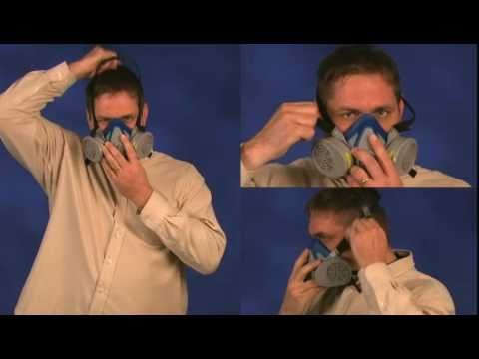
Respirator Donning and Doffing
(OSHA Video)
Notes:
Stop after first 4 minutes

Slide 33
Personal Protective Equipment
DHCP (dental health clinic personnel) MUST use proper PPE when exposed to patients. PPE differs for the care of well patients during the COVID-19 pandemic versus PPE needed when providing emergency care to a patient with suspected or confirmed COVID-19. OSHA recommends the following PPE for DHCP during the COVID-19 pandemic…..

Slide 34
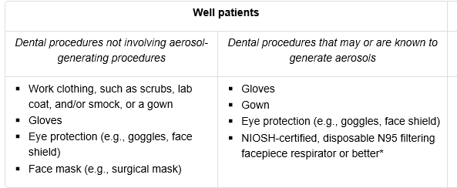

Slide 35
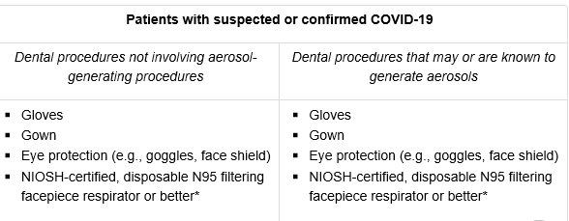

Slide 36
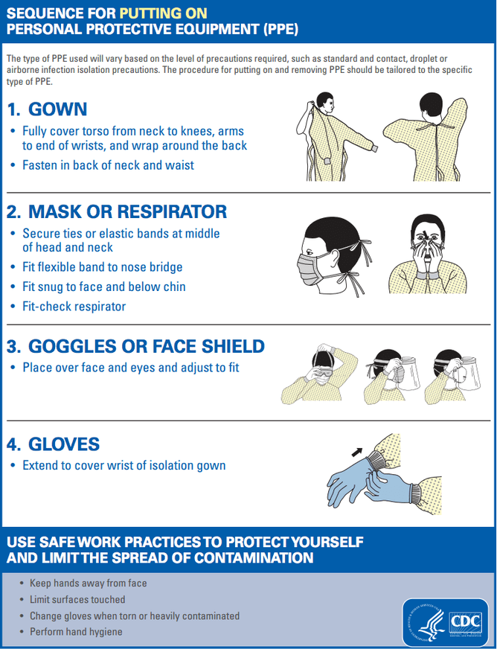

Slide 37
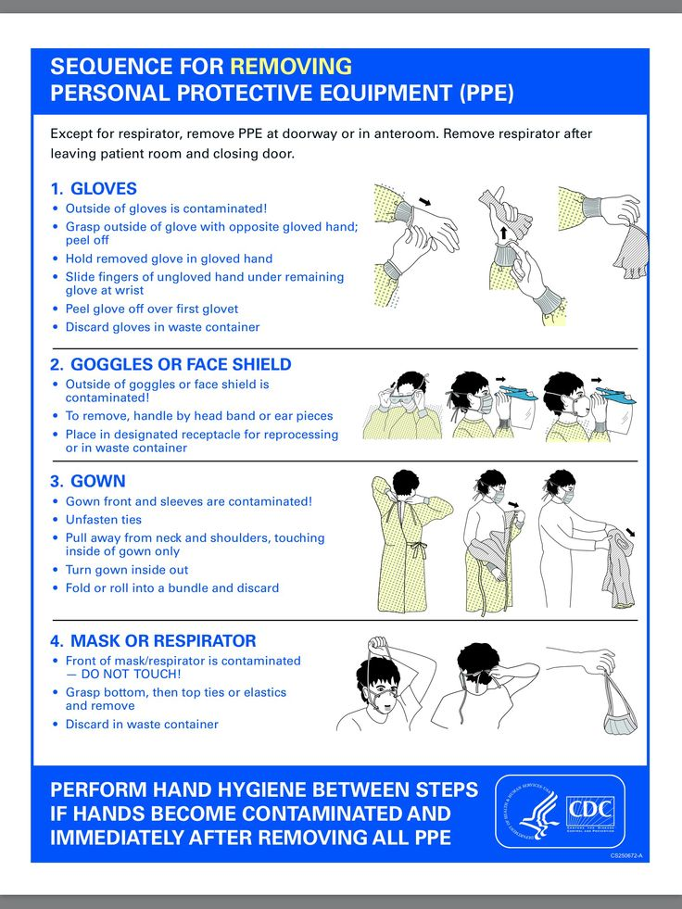

Slide 38
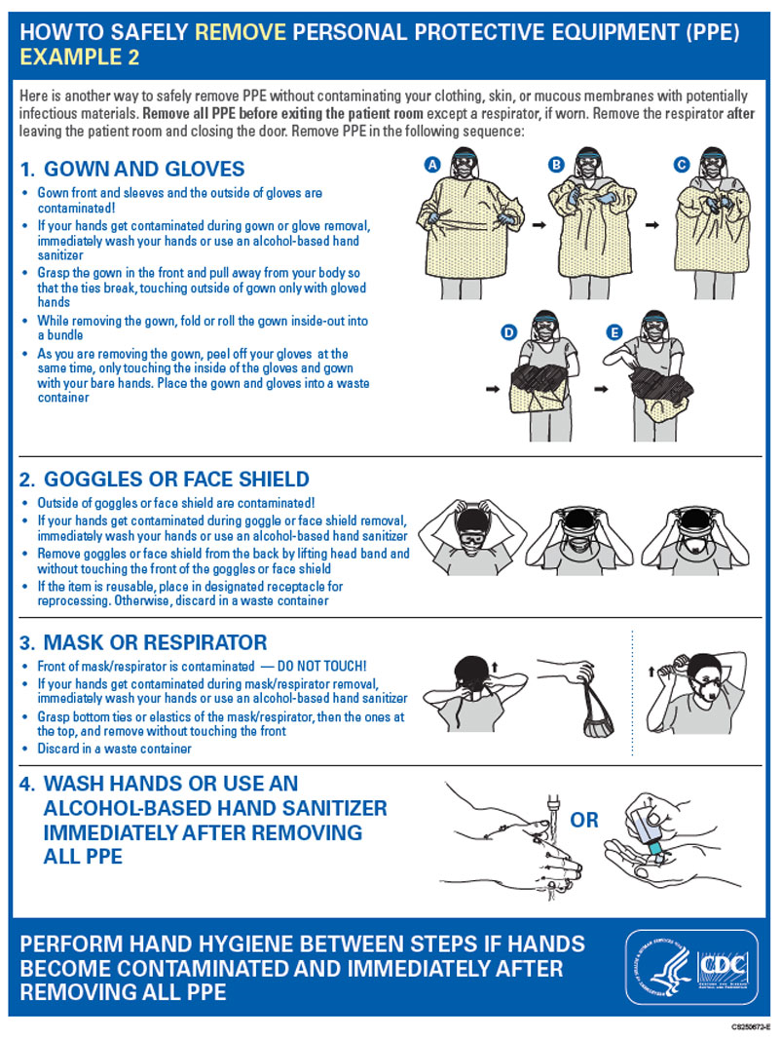

Slide 39
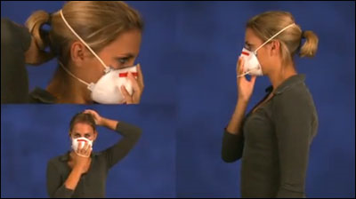
Donning a Respirator
(putting on)
Molded Cup Respirator:
Hold the respirator in the palm of your hand with the straps hanging loose.
Place the N95 respirator on your face covering your nose and cupping your chin.
Pull the upper strap over your head, resting it high on the crown or back of your head.
Pull the bottom strap over your head, and behind and below your ears.
Mold the nose piece of the respirator over the bridge of your nose to obtain a tight seal.
Perform a seal check to ensure there is a good seal against the skin.
Notes:
In this final section, we will cover the proper procedures for donning (putting on) and doffing (removing) a respirator and for performing a user seal check. Always follow the manufacturer’s instructions for wearing a respirator. These instructions are found on or inside the box the respirator came in. In general….
…to don a molded cup N95 -
Hold the respirator in your hand with the molded nose contour (the narrower end) at the finger tips, allowing the headbands to fall below your hand.
Place the respirator on your face. The nosepiece should span and cover the bridge of your nose and the respirator should cup your chin. The nose cushion must be uncreased inside the respirator.
Pull the top strap over your head resting it high at the crown or back of your head.
Pull the bottom strap over your head and position it around your neck and below your ears. Long hair should be moved out of the way so the bottom strap touches the neck. Be sure not to crisscross the straps.
Use both hands to mold the nosepiece to conform to the shape of your nose by pushing inward while moving your fingertips down along both sides of the nosepiece.
Next, conduct a user seal check.

Slide 40
Donning a Respirator
(putting on)
Panel (Folded) Respirator:
Open the folds fully.
Hold the respirator in the palm of your hand with the straps hanging loose.
Place the N95 respirator on your face covering your nose and cupping your chin. Ensure the panels are fully expanded.
Pull the upper strap over your head, resting it high on the crown or back of your head.
Pull the bottom strap over your head, and behind and below your ears.
Mold the nose piece of the respirator over the bridge of your nose to obtain a tight seal.
Perform a seal check to ensure there is a good seal against the skin.
Notes:
The procedures for donning a panel or folded N95 respirator are essentially the same.
However, you must remember to fully expand the panels of the folded respirator before you conduct the user seal check.

Slide 41
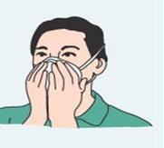
User Seal Check
Perform both before every use:
Positive pressure check – Cup hands over respirator. Blow out gently. Feel for a slight bulging. Air should not leak out through the seal.
Negative pressure check – Cup hands over respirator. Breathe in sharply. Feel for a light collapse. Air should not leak in through the seal.
Notes:
A seal check should be performed each and every time you don a respirator.
Follow the manufacturer’s seal check instructions found on or inside the respirator box.
In general, the manufacturer’s instructions are to cover the surface of the respirator with the palms of your hands so that air is prevented from passing through the filtering facepiece. Don’t press so hard that you artificially increase the pressure on the seal at the edges of the respirator.
A positive pressure seal check is performed by gently exhaling to see if the facepiece bulges slightly. Also, feel for air escaping the seal onto your face or eyes.
A negative pressure seal check is performed by taking a quick, deep breath to see if the facepiece collapses slightly or you feel air leaking in through the seal.
During either seal check procedure, if you feel air leaking, the respirator may not fit your face properly. Readjust the fit of your respirator and check the seal, again.
If you cannot achieve a proper seal, you are not protected and should not use that respirator.

Slide 42
Doffing a Respirator
(Removing)
Only touching the straps, pull the bottom strap over the top strap and your head, and release the strap
Holding the upper strap, pull the respirator forward and away from the face
Discard the respirator into the trash, still using only the straps
Wash your hands with soap and water or hand sanitizer
Notes:
When you are finished wearing the respirator, only handle the straps of the respirator. Carefully remove the respirator without touching the exterior, because the exterior may be contaminated.
Discard your respirator according to your standard procedures or supervisor’s instructions.
N95 respirators often can be reused if they are not torn, soiled, wet, or otherwise damaged. They should be stored in an appropriate container or bag.

Slide 43
Thank you for participating in this Respiratory Protection Program
Wellness Pointe

